Slide 1


Slide 2


Slide 3


Slide 4


Slide 5


Slide 6


Slide 7


Slide 8


Slide 9


Slide 10


Slide 11


Slide 12

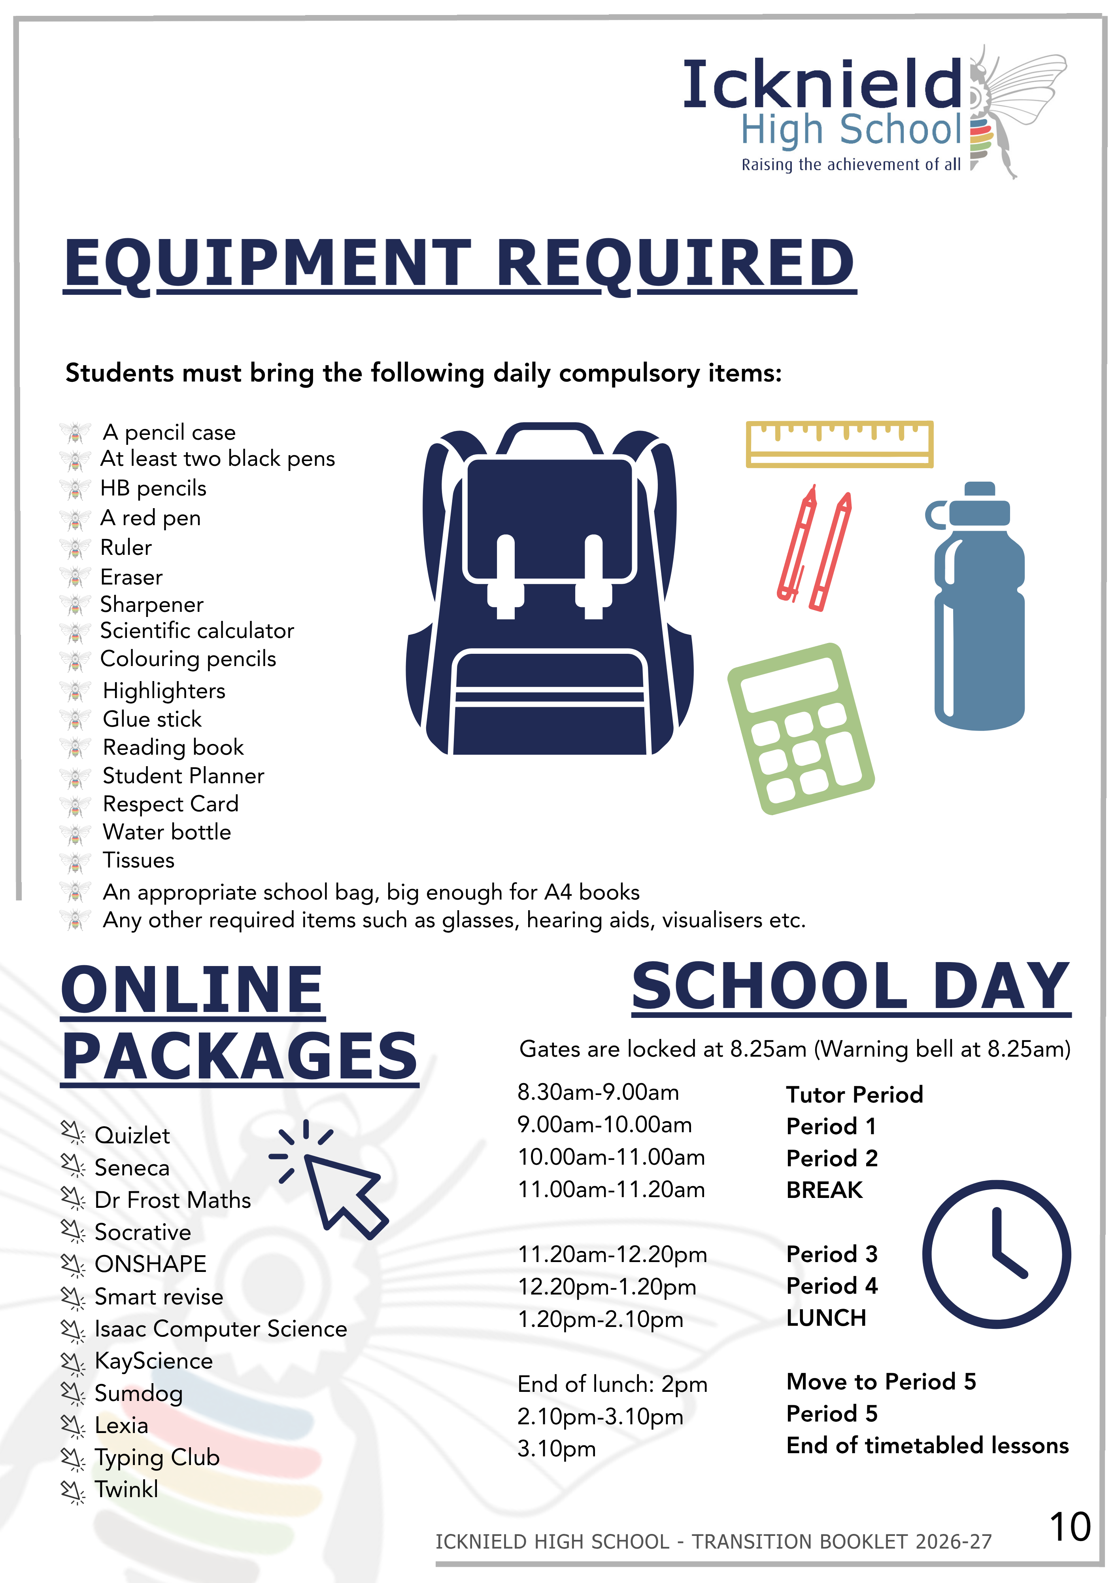

Slide 13


REPORTING ABSENCE & RETURN TO SCHOOL
EXAMPLES OF AUTHORISED &
UNAUTHORISED ABSCENCE
AUTHORISED ABSENCE
Emergency Doctor or Dental Appointments (evidence required). Routine appointments should be made outside of school hours where possible.
Hospital or Orthodontist appointment (evidence required)
Funeral (1 day, if local); please send in a letter to Mrs Zabbair.
Extra Curricular Sporting Activities and Cadet Activities (evidence required)
College/Careers/Work Experience Interviews (Evidence required)
UNAUTHORISED ABSENCE
Holiday absences are never approved by the school.
Absence not reported on the day or supported by written explanation upon return to school.
Absence of 3 or more days without medical evidence.
Arriving late after registers have closed at 9:00am.
Truancy (both internal and external).
All absences must be reported before 8am each day. The absence line is automated and available 24 hours a day. Illness is authorised at the discretion of the school.
An Absence Alert Text is sent after 10:00am each day of unreported absence which you can reply to please ensure we have up-to-date mobile phone number and contact details.
If you know your child is going to be absent (for example medical appointments etc), please let us know in advance by contacting
Mrs Zabbair (Attendance Officer)
Parental handwritten notification of absence must be signed by a member of your child’s relevant Year team to be authorised and if it is for an appointment it should be shown to Reception on signing out.
On return to school we ask that you provide us with a reason for absence either via letter or directly to Mrs Zabbair.

Slide 14


Slide 15
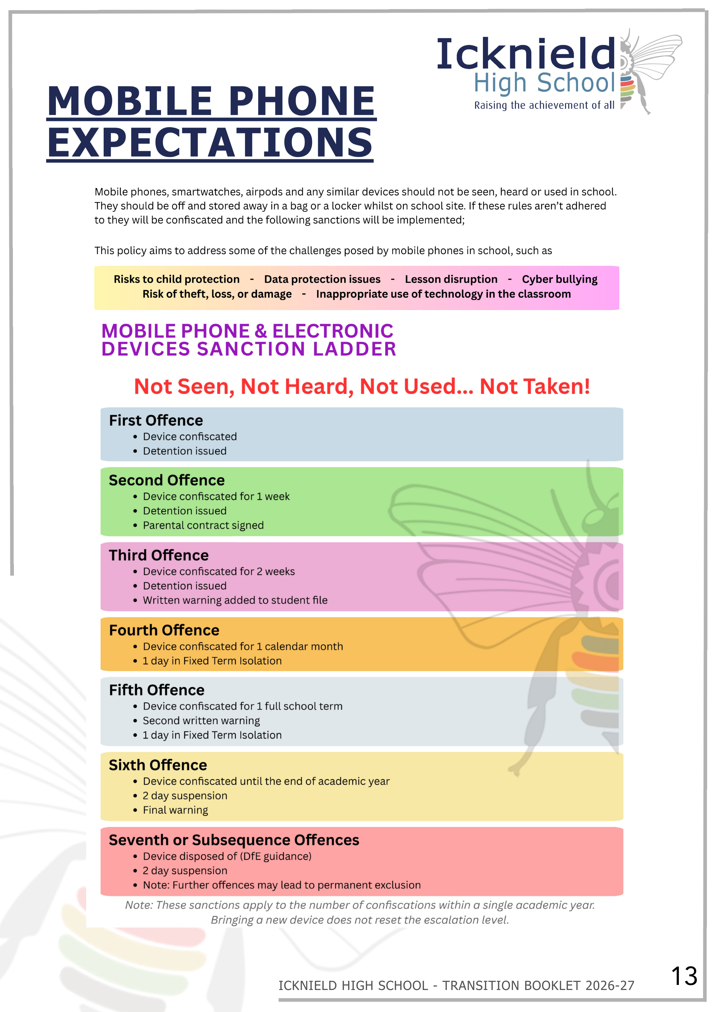

Slide 16


Slide 17


Slide 19


Slide 20


